Slide 1
Maths in the Early Years

Slide 2
What do the children need to know and remember this year?
This is our focus for the first term to help to embed the number sense that all the children naturally have.

Slide 3
Our end points for Reception.

Slide 4
What is subitising?
It is the ability to know how many are in a set or group without counting them.
Children develop this skill from birth but sometimes the skill isn’t used once they are encouraged to count.
We know children can use their skill of subitising to see amounts beyond 10 and this helps them with their early addition and subtraction knowledge.

Slide 5
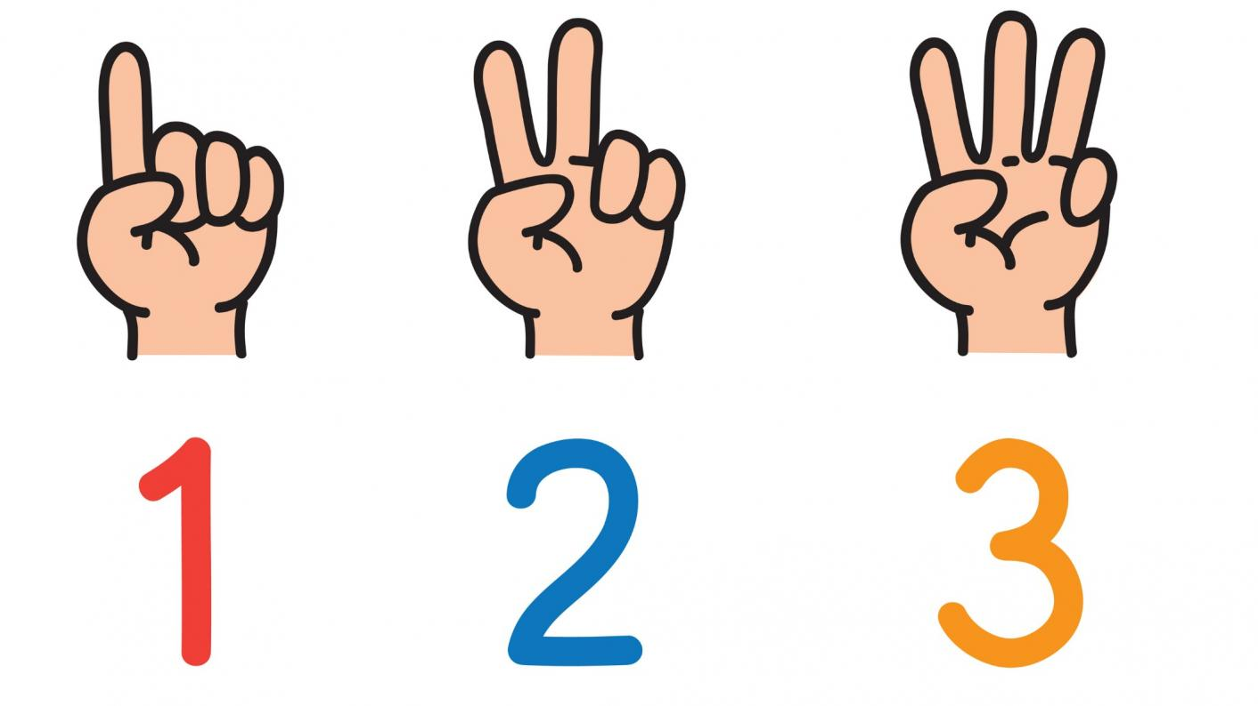
What is subitising?
What can you see? How do you see it?

Slide 6
What do you see? How do you see it?

Slide 7
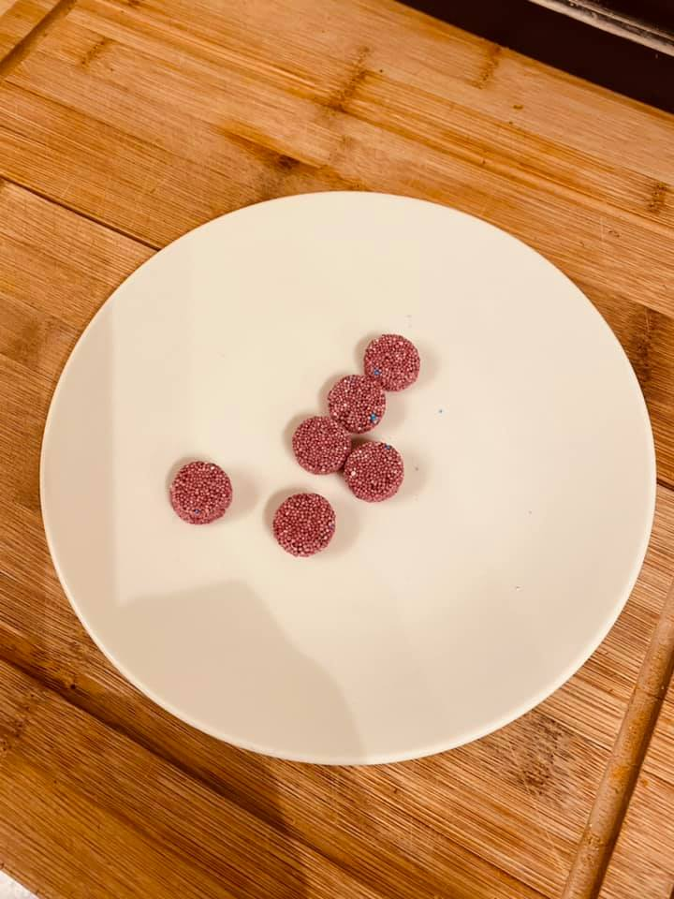
Use any objects but keep things clear and simple

Slide 8
What next?
We use five frames and ten frames to work out how many objects we can see to support our subitising.
Our self registration every morning…..

Slide 9
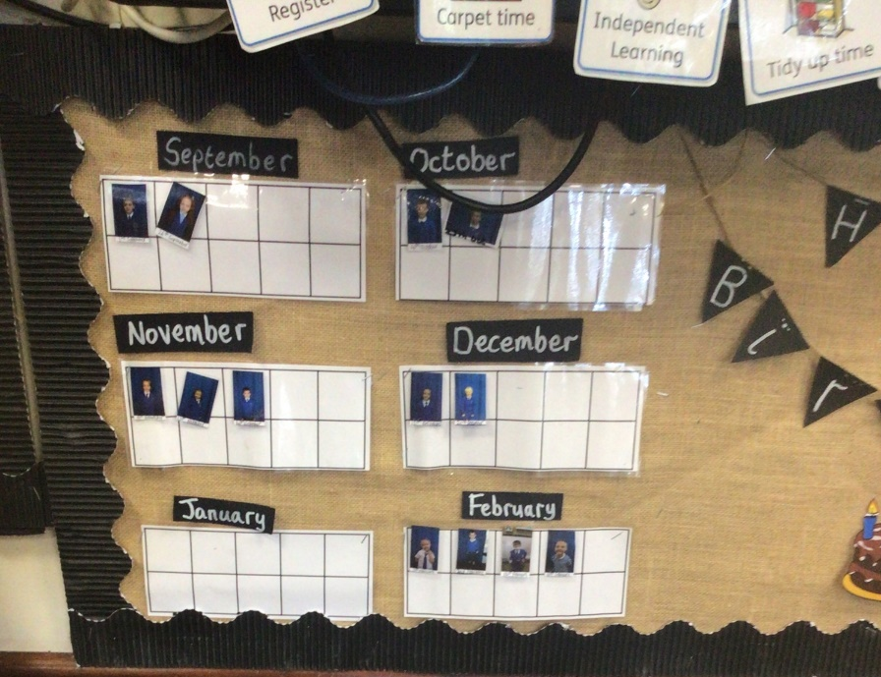
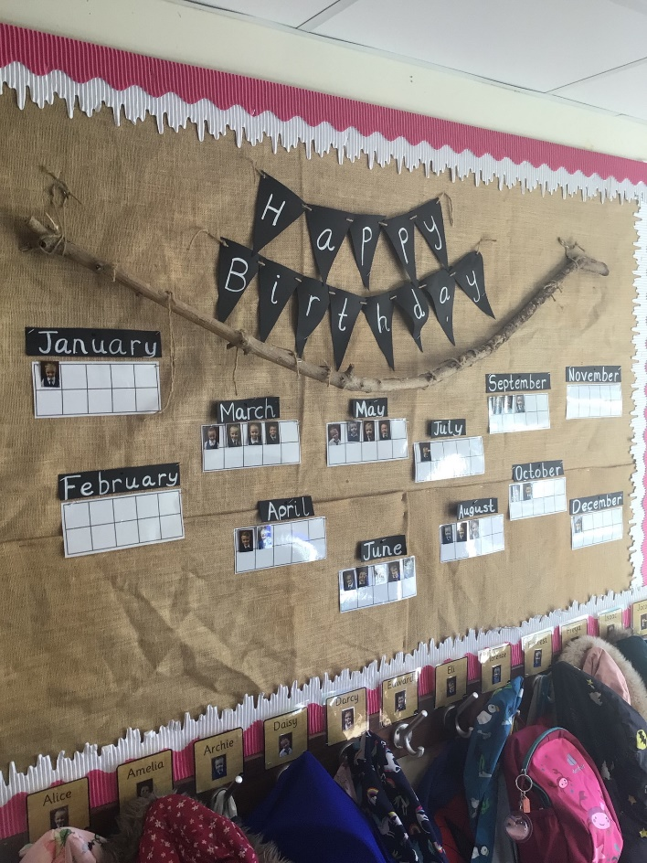
Voting for stories, our birthday displays and rating our story books all involve subitising and using five and ten frames

Slide 10
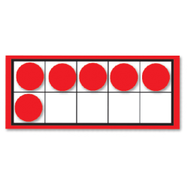
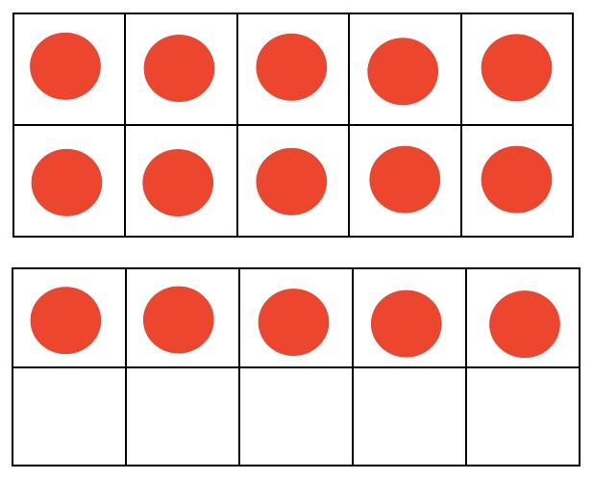
Maths is everywhere. Using five frames and ten frames as part of everything we do.
There is a set way to fill a five or ten frame.

Slide 11
How do we use them?
Finding out who is here every day
Voting for the story to read at the end of the day
Rating books we have read
Counting down to events
Finding out how many are there without counting when there are large amounts
Making sure we have the correct amount of objects without counting them
We use concrete materials throughout the year but also model how this can look if we draw these rather than using resources. This is called ‘pictorial’.

Slide 12
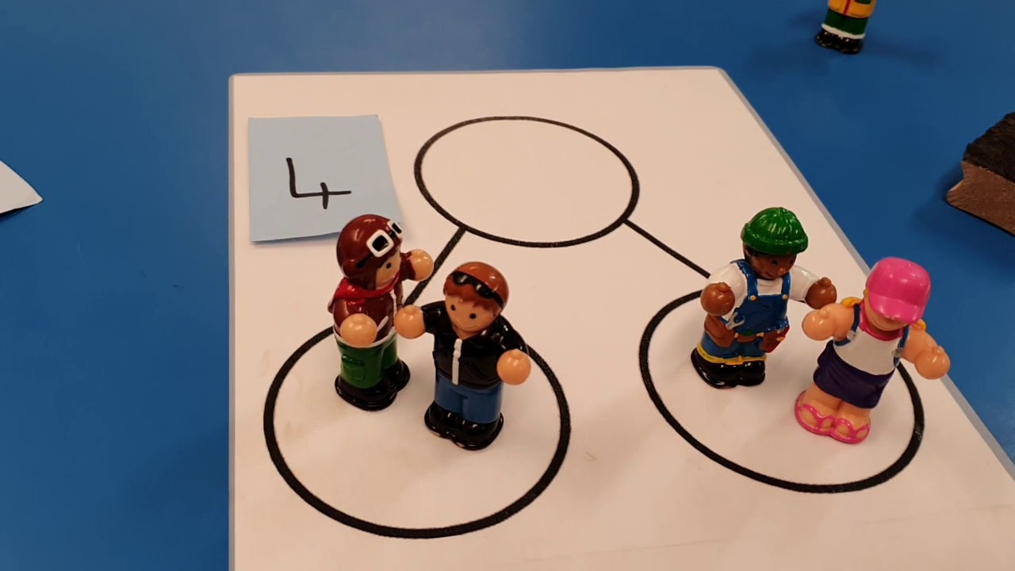
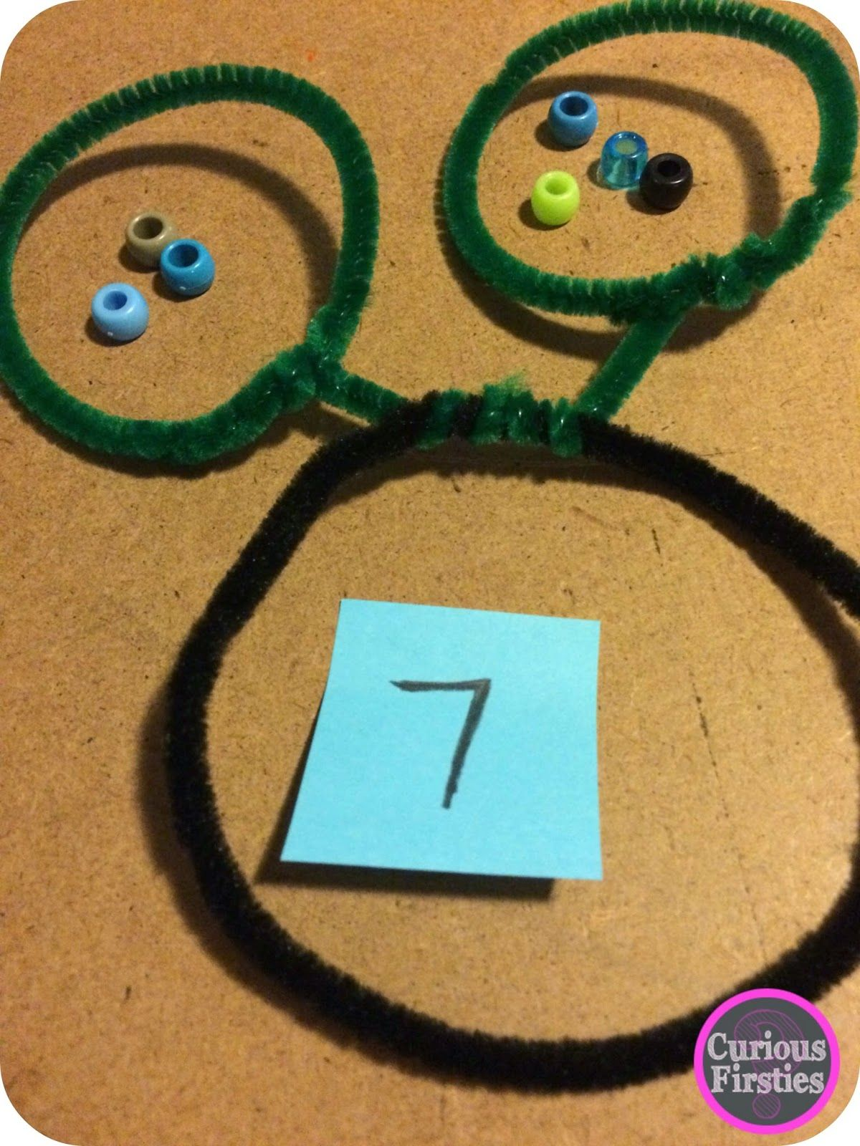
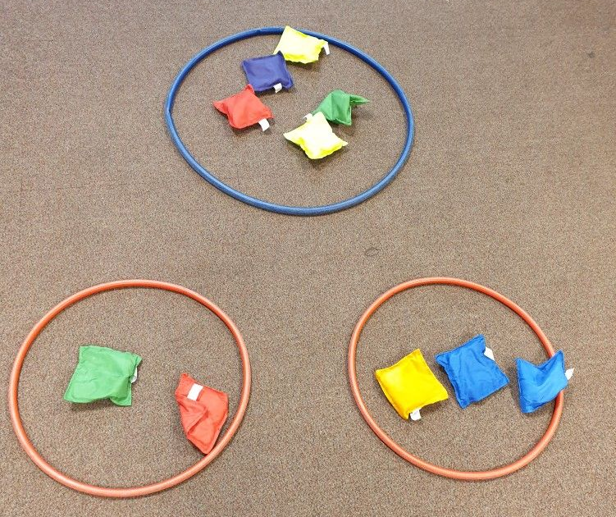
What else?
- Automatically recall number bonds for numbers 0-5 and some to 10.
We use part whole models to help the children to find these number bonds and recall them.

Slide 13
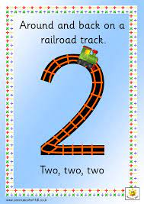
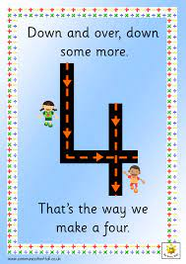
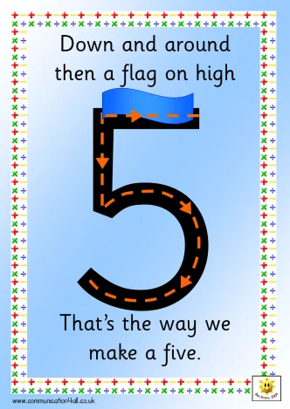
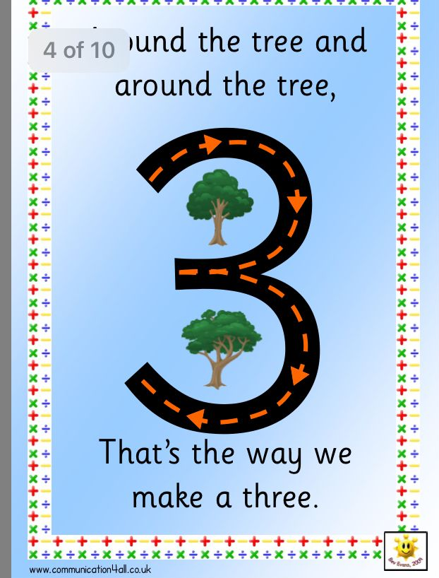
Alongside this we practise forming the numerals to match the quantities we see.

Slide 14
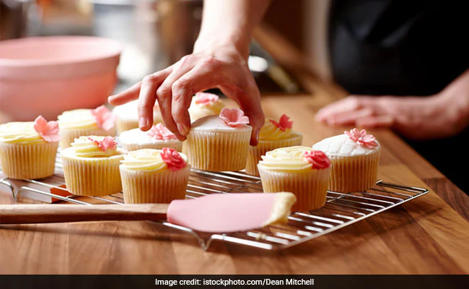
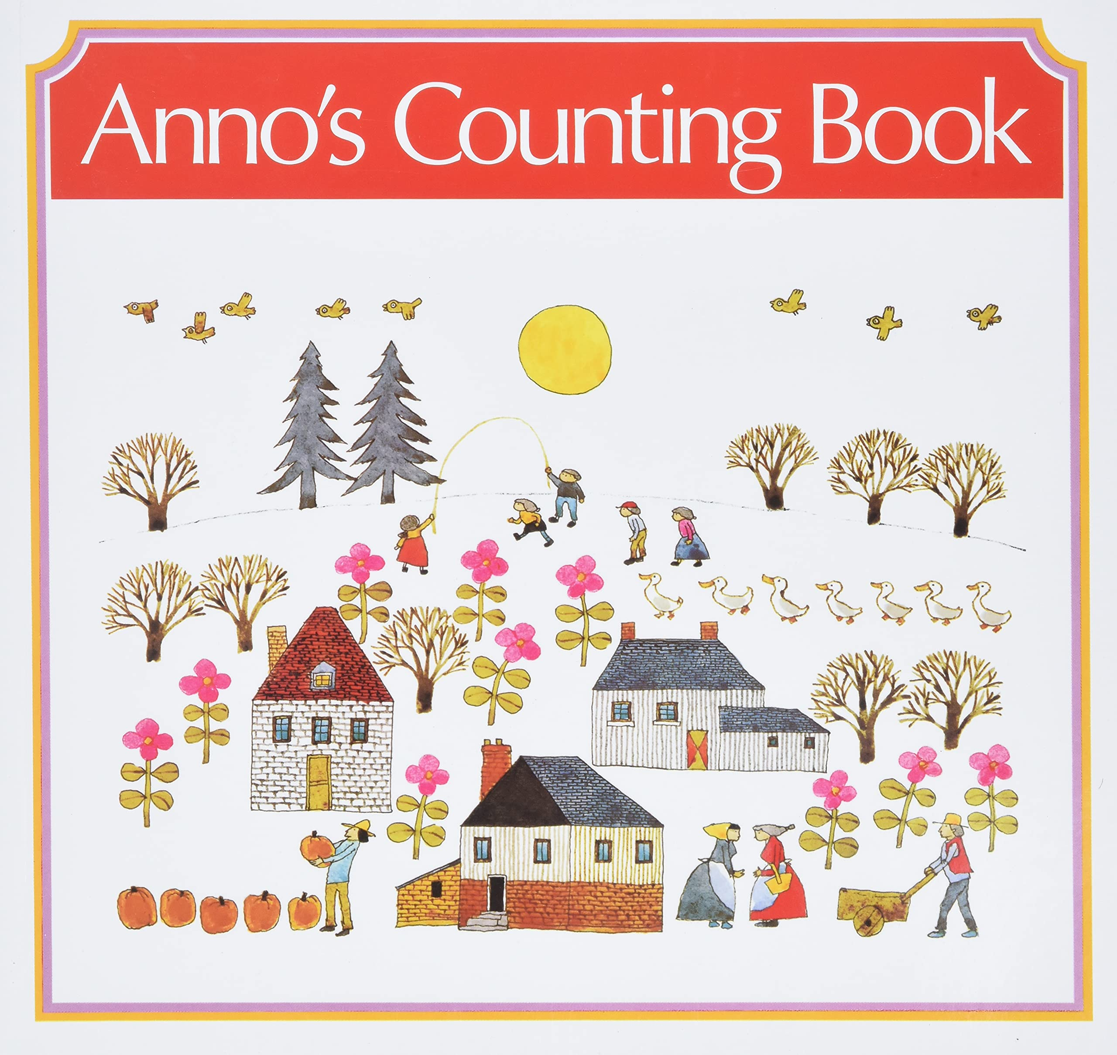
How can you help at home?
Spot amounts and numerals on walks or whilst you are out and about
Encourage your child to subitise amounts – in nature, food, toys – avoid counting if you can – ask “what can you see?”
Talk about ‘one more’ and ‘one less’ than amounts and what that might look like (food and baking or cooking is a good opportunity for this)
Encourage talk about what they can see in story books –use the pictures – can they subitise what they see?

Slide 15
Numbots
This is being trialled across the school as a way of supporting maths at home
Maths games for the children to play on a tablet or phone that support their school maths learning
Teachers will set the tasks that are appropriate and support the learning in class
There will not be a set amount of time to spend on Numbots and using it will be optional
https://www.youtube.com/watch?v=AeO2u2bSD6A

