Slide 1
What do I need to know?

Slide 2
What is Read Write Inc?
It is a programme to help children to become confident readers and writers.
The programme is very successful and commonly used in many primary schools.
It is designed to enable every child to become confident and fluent readers at the first attempt.
Children are able to learn to read at a pace that suits them.

Slide 3
What will the lessons look like?
The scheme uses a phonics based approach.
All children learn to read sounds and blend the sounds together to read words.
During their year in Reception the children will learn 44 sounds. These are called SPEED SOUNDS.
Each sound is accompanied by a simple picture prompt.
These known sounds are reviewed daily and new sounds introduced.

Slide 4
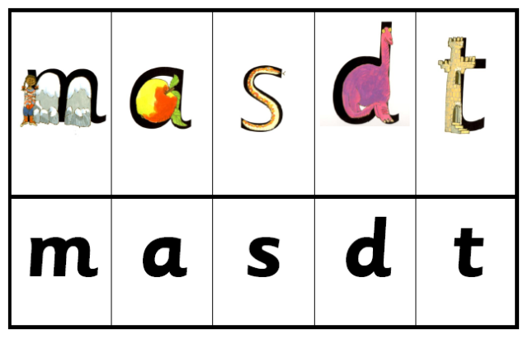
We use letter sounds only.
Focusing on PURE sounds.
See the guide for parents for help with pronunciation.
No letter names at this point.

Slide 5
The letter sounds are split into two groups – bouncy sounds (b,d,g,t etc)
and stretchy sounds (m,n,s etc)

Slide 6
The sounds are broken into smaller groups of four or five.
Once a group of sounds has been taught the children will learn to blend these sounds to read real words.

Slide 7
For example
m a t d a m
s a t s a m
s a d a t

Slide 8
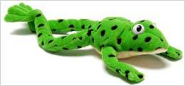
I only talk in sounds!
Fred Talk
The children are ready to blend sounds when they know the sounds in and out of order.
We call this Fred Talk.
c-a-t - cat
d-o-g - dog

Slide 9
Read Write Inc lessons in Reception
Whole class speed sounds recap and introduction to new sound.
Listen to words beginning with that sound.
Look at pictorial prompt for new sound.
Listen to Fred Talk of simple words with new sound.
Learn shape of new letter sound, using handwriting phrase (m = Maisie mountain mountain)
Have a go at forming letter in the air before having a go at writing it, following a visual prompt.

Slide 10
Read Write Inc lessons in Reception
Word Time
Once the children are confident with the first set of sounds they will be taken in small groups to use magnet boards to create a range of words using these sounds.
If they are able to form the letters correctly we will encourage them to have a go at writing a few of the words they make.
Red Words
These are words that cannot be blended easily (the, was, my). We will send a few of these home once the children start to learn them. The only way to learn them is to recognise how they look.

Slide 11
Read Write Inc lessons in Reception
Children will stay as a whole class to learn their sounds until at least half term.
From then on the children will be put into ability groups across the three classes and spaces and taught at a level that will support and challenge them.
The groups are small and each group will be taught by a teacher or TA that has been trained to teach Read Write Inc.
Whole class sessions will last for up to 20 minutes.
Once the children are in the ability groups these sessions will gradually lengthen up to 45 minutes.

Slide 12
Additional support
It is important that the children develop a strong, confident pencil grip and the stamina to write words and, eventually, sentences independently.
The children will have access to…
Funky Fingers activities during Independent Learning
Write Dance, Dough Disco and pincer grip challenges
Name writing practise
Intervention activities if needed
Opportunities to make marks and write indoors and outside

Slide 13
How can I help at home?
Look at Class Dojo regularly to see which sounds have been taught and use the green Set 1 sounds book to practise them with your child. 5 minutes a day is a great start.
Encourage your child to practise writing the sounds with their pinchy pencil grip on their pencil.
Once the children are confident with several groups of sounds we will send home some simple word reading books for the children to practise reading. They can also practise writing these words if they are keen.
Please try to spend at least 5 minutes every day practising any sounds and words that come home. Little and often is key.

Slide 14
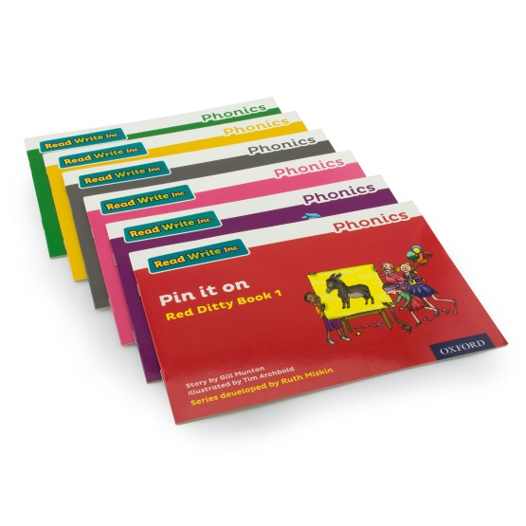
When will my child bring home a reading book?
Children will have opportunity to choose and take home a class library book each week. This is to share with you at home.
The children will have a reading record log where you can log when you share the book with them.
Scheme reading books are sent home when the children start in their Read Write Inc ability groups. They will bring home a paper copy of the book they are reading in the lessons. They will also bring a book bag book that has sounds and words linked to their learning in RWI lessons.

Slide 15
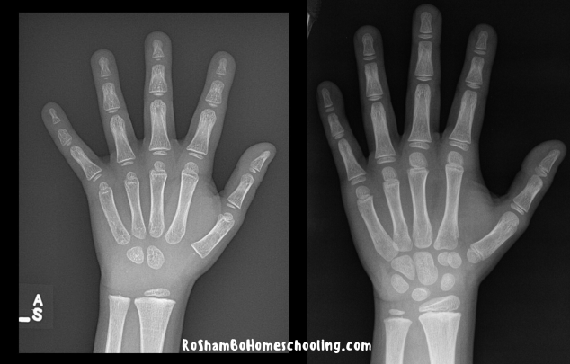
Writing in Reception.
Children need good gross motor skill as well as fine motor skill to be able to write.
Hand development
3 year old
Hand development
7 year old

Slide 16
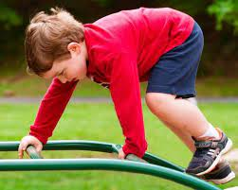
Gross motor skill development.
Throughout their time in Nursery and Reception the children are developing core strength and hand muscles in order to be ready to write. Until these are developed securely the children will not be able to develop the fine motor skill they need to be able to hold and control their pencil or pen.
Ways in which we help the children to develop these gross motor skills….
Using bikes and trikes
Climbing and pulling themselves up with their arms
Our Real PE sessions focus on core skills including balance and agility
Creating obstacle courses
Giving the children space to move
Using large equipment – brushes, mops, rollers
You can help at home by visiting the park with your child, allowing them to go for walks with you, using their scooter or bike, encouraging them to run, jump, climb and pull themselves up using their core.

Slide 17
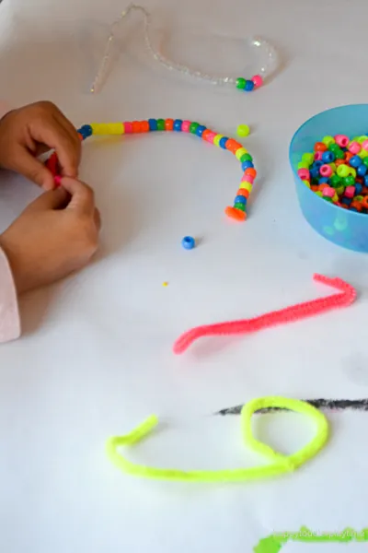
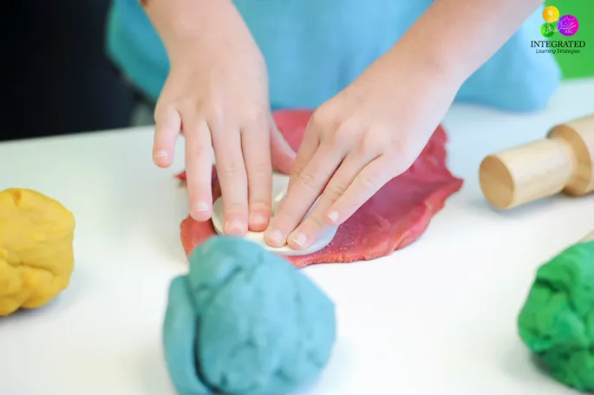
Lots of fine motor activities need to take place before a child is ready to pick up a pencil correctly and write. The following activities can help children to develop their hand muscles and fine motor skill in order to be ready to hold a pen or pencil…..
Squeezing playdough
Threading beads
Using pegs to clip things together
Building towers
Using tweezers
Pick up small objects
These are planned into our provision and children who need these activities are encouraged to try them.
We also plan for whole class activities at this time of year to support this development…
Whole class activities which support this development….
Write Dance
Dough Disco
Finger rhymes
Fine motor challenges – 1 minute challenges

Slide 18
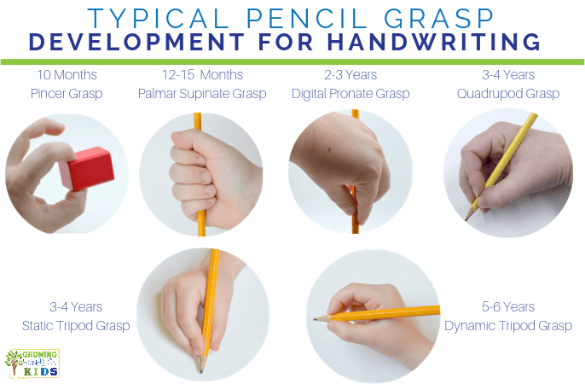
What does writing look like in Reception?
Although these stages have ages attached to them children develop at different rates.
We see children with every grip seen here. We spend lots of time modelling and practicing what a tripod grip looks like.

Slide 19
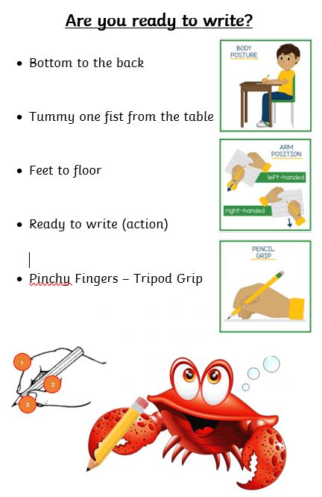
Being ready to write.

Slide 20
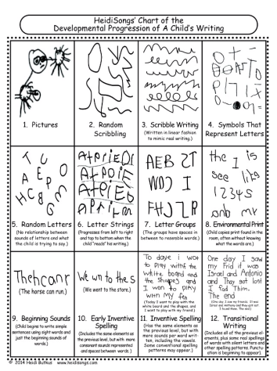
We encourage the children to make marks during their play as well as in set tasks with an adult.
All writing tasks have a purpose.
Writing materials are on offer in every classroom and outside. Children are encouraged to access and use these as part of their play.
Mark making is modelled by all adults.
Children have the opportunity to practise the letters they have learnt so far. Their formation is corrected when needed to ensure they avoid developing bad habits that are difficult to fix later.

Slide 21
Drawing Club encourages the children to make marks imaginatively. Stories are used as a hook and teachers model drawing a picture that links to the Drawing Club focus.
The children are introduced to new language with every story and they practise this everyday, using actions to help them to understand the meaning of the words.
The adult reads the story every day so the children are familiar with it. They practise the new language every day.
Each day the adult models drawing something linked to the book, incorporating phonics, maths and other topic links. Children are invited to come to Drawing Club to draw their own version. As the year goes on the children become more independent in this and the whole class will take part at the same time, all drawing together.

Slide 22
How can you support at home?
Encourage your child to make meaningful marks.
Cards
Letters
Invitations
Lists
Praise them for having a go.
Encourage them to prepare to write.
Have mark making materials on offer – notebooks, cards, paper, pencils, pens, chalks, paint, mud/sand and sticks if outside.
Don’t correct the formation unless you know they KNOW the letter sound already. We will share the letter sounds they know on Class Dojo. Encourage your child to practise forming these correctly at home, using the handwriting phrase.

