Slide 1

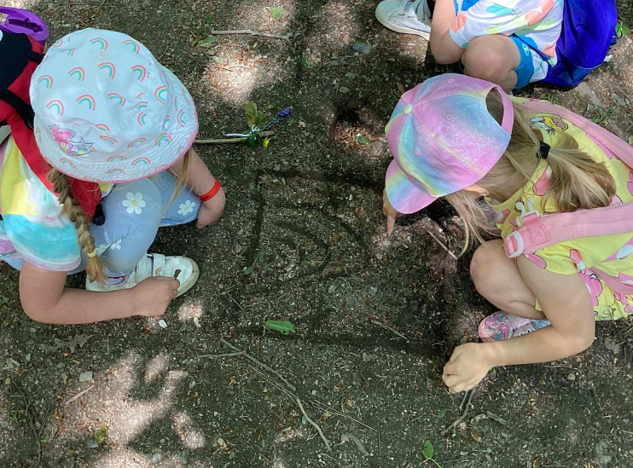
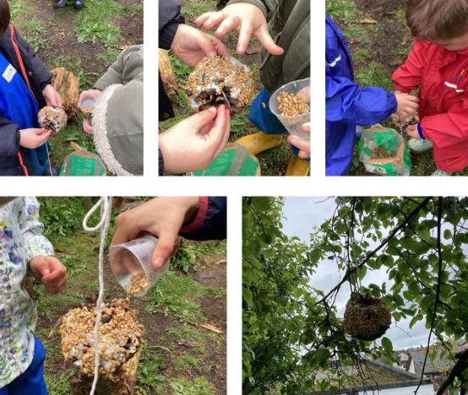
Welcome to Trewirgie Infants’ School!
What to expect of the Reception year.

Slide 2
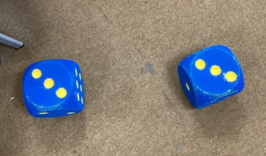
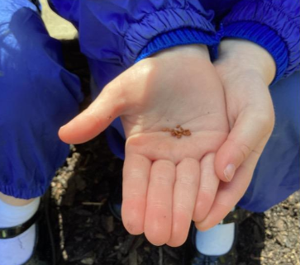
A day in Reception
The children are greeted by a member of staff from their class as they enter the classroom.
The children are in charge of hanging coats on their peg and placing book bags in the classroom storage place.
Each class has an area for packed lunches and drinks bottles.
The children sit on the carpet together once they have sorted out their belongings. This is a time for songs and rhymes and, once the children have settled, a time to practise some things they have been learning. This could be sounds, name writing and fine motor activities initially.

Slide 3
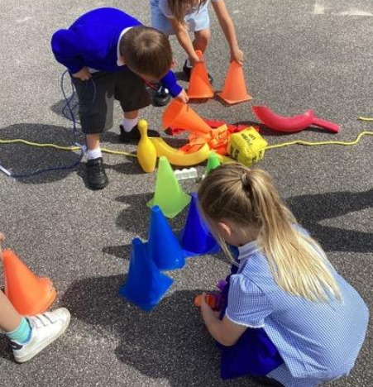
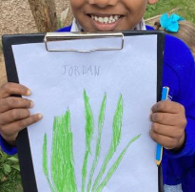
A day in Reception
Once everyone has arrived and settled it is our class registration time. It is a great opportunity for maths.
Once they have registered we have a short taught session – Read Write Inc where the children start to learn their sounds and learn to read. This will be explained in more detail later in the month.
The children eat their snack together as a class. Fruit, milk and water is provided. They can drink their own drink at this point.
There is a short taught session after lunch. The taught sessions build up as the year goes on and the children are able to focus for longer periods.
Throughout the day there are Independent Learning sessions.

Slide 4
What is Independent Learning?
There are at least two Independent Learning sessions each day. There are more of these during the first term.
Each session is at least 45 minutes long in the morning and can be up to an hour and a half in the afternoon.
It is an opportunity for the children to explore the learning opportunities in the classrooms and outside. They can explore any room.
It is an opportunity to socialise with others who enjoy the same activities.
Adults are on hand to support, interact, observe and engage the children. It is used as an opportunity to move the children’s learning forward in a playful way. Everything that is on offer to the children has been carefully thought through and has a purpose.

Slide 5

What to expect in the first few weeks?
The staff will be getting to know the children by playing with them and chatting to them. The All About Me books are used lots during this time.
Once the children are settled the staff will be carrying out BASELINE activities with the children.
One of these is a statutory baseline for the Department of Education
It is completed with each child. Teachers input results online. Some of the activities completed inform us of what the children already know. Information about this statutory baseline will be sent home shortly.
In addition to this we complete our own play based activities which help to inform us about the children.
We also complete a short Read Write Inc assessment so that we know and understand the starting points of all children.

Slide 6



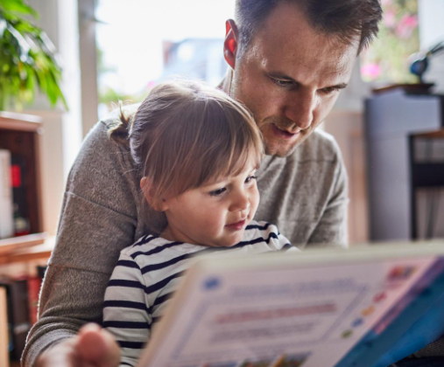

How can you help?
Be positive about school
Bring your child to school every day and on time
Ensure your child has everything they need
Coat, boots and waterproofs, a drink in a refillable bottle, names uniform
Help your child to have a settled start to their day – routine is important
Read to your child every day – even just for 5 minutes
Practise activities that come home - sounds
Log on to Class Dojo
Talk to your child about what has happened at school each day using Class Dojo
Become a member of our PTA to help to raise funds for us to support our curriculum
Complete the school readiness questionnaire to let us know how ready for school you feel your child is – be honest! We will use your answers and our observations to design our curriculum for the year.

Slide 7
Class Dojo
Many of you are already on Dojo, however do not worry if you are not we will send your child will come home with a log in invite for you. Scan the QR code on your phone and we will accept you onto the class page.
We will use this regularly to show you photos of what the children have been doing, things you need to remember and things that will be happening the following week.
We also use this to communicate with you on an individual basis if we don’t manage to see you face to face. We welcome you to use this as a way of communicating with us if you are unable to see us in the morning or at pick up time.
Please don’t hesitate to get in touch if you are worried about anything. It is also a great way to show us what your child is able to do and what you are proud of throughout the year. We regularly ask for photos to support the children’s learning.

Slide 8
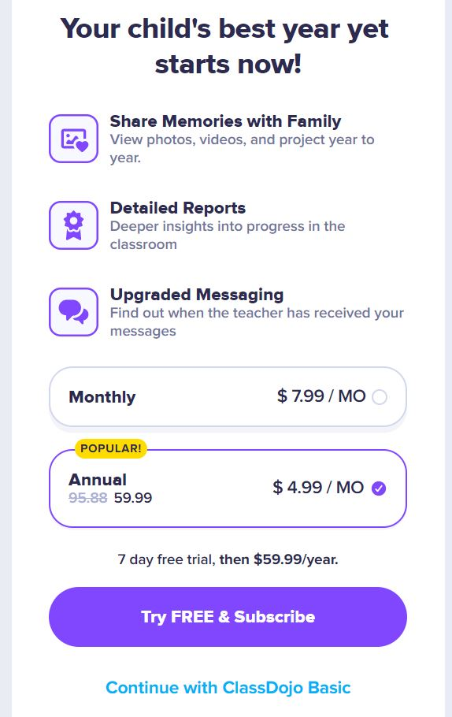
If you already have children at the school you can add your child to your existing account.
ClassDojo Basic is free to use.

Slide 9
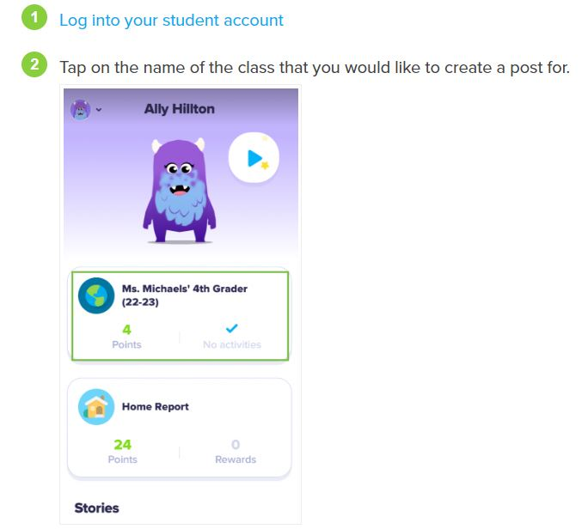
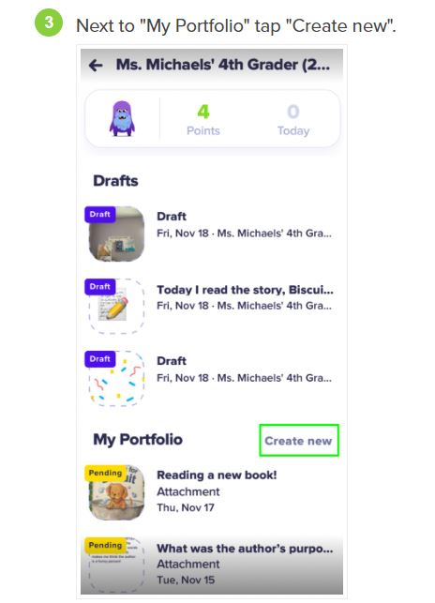
Uploading work and photos for us to see

Slide 10
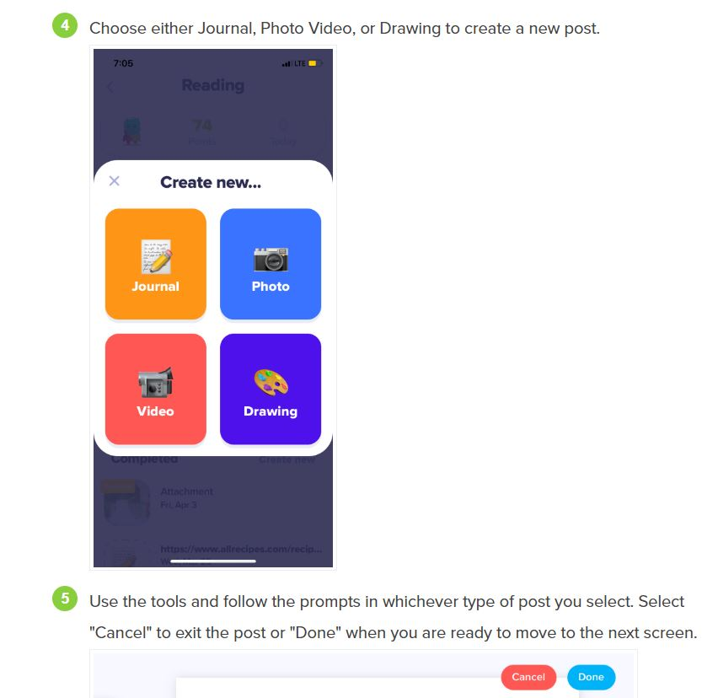

Slide 11
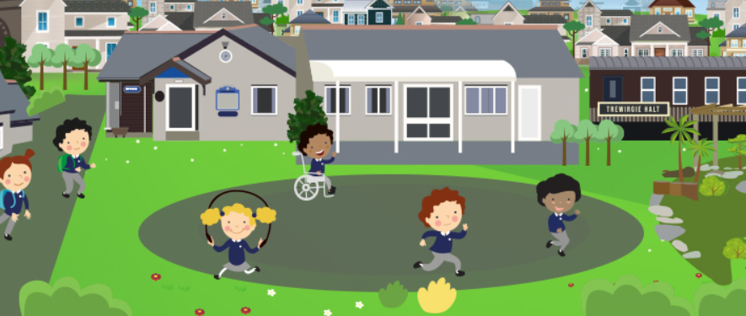
Ways to get in touch
Face to face at drop off or pick up times
Via Class Dojo – private messages to class teachers are the best way. We can’t always see comments on whole class posts
Via the school office
Email

Slide 12
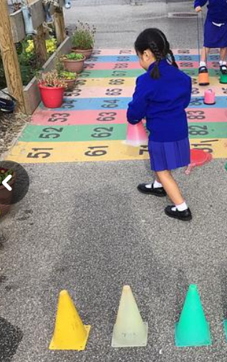
What will my child be learning?
Our topics and learning consider the children’s interests as well as what they are expected to know and do during their reception year.
We will always use Class Dojo to show you what the children have been learning.
We share our planning on Class Dojo each half term.
We will be inviting you in to be part of your child’s learning throughout the year.

Slide 13
What will my child be learning?
We will also ask you to be involved in supporting your child with their learning at home, in particular with their reading. We know that reading is vital in supporting children to succeed in their learning and throughout their lives and welcome you to be part of your child's reading journey.

Slide 14
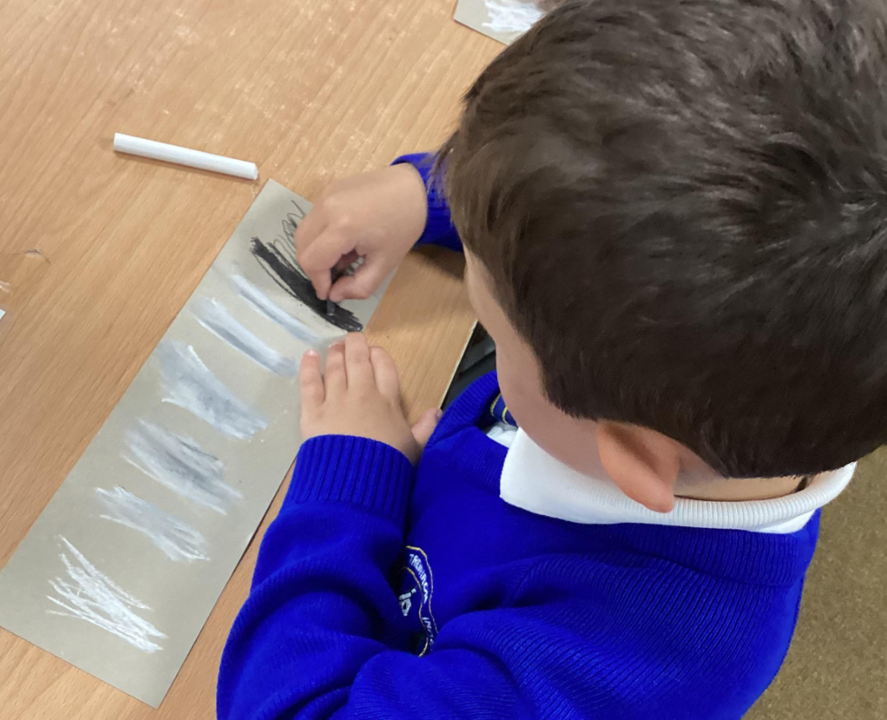
Please feel free to have a look at the floor books we created last year to document our learning.
If you have any questions please ask, or if you think of anything at a later point please contact me or your class teacher.
Thank you!

